Slide 1
Meta Materials: Structural Application & Future
By: Helder Rebelo

Slide 2
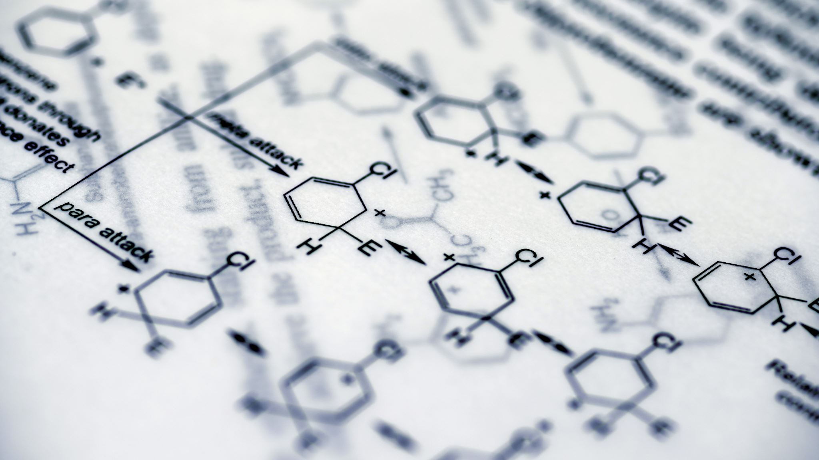
Introduction To Meta-Materials
LATTICE LATTICE LATTICE
Metamaterials are a type of engineered material created to have properties that naturally occurring substances cannot achieve. Meta-Materials get their properties from micro and macro structure that are engineered unlike conventional materials that that rely on their chemical composition.
In structural engineering, metamaterials present groundbreaking opportunities by improving strength, durability, and versatility. Today, we will concentrate on their structural applications, setting aside their thermal and acoustic characteristics, and emphasizing the significance of fracture research in the development of these materials.

Slide 3
Structural Applications Of Meta-Materials
Metamaterials are currently being tested for building earthquake application as auxetic metamaterials can be designed to distribute stress evenly loving for stronger shock absorbing materials.
Metamaterials are currently being implemented in load bearing beams as changes to the lattice structure of certain materials can create much stronger materials better equipped for taking on large loads.
Self healing metamaterials are another great application for metamaterials as it gives a way to fix cracks in a material rather than replacing the material entirely.
Metamaterials have also seen a large increase in military application. Metamaterials have proven to have useful characteristics in response to blasts, allowing for advanced military application.

Slide 4
Current Needs and Challenges
Currently the main downside of using metamaterials in all sorts of applications is the very little information we have about them. Conducting further research and experiments with metamaterials and superficially fracture analysis of metamaterials would allow for a broader range of applications. Having all the information necessary to create a material with known and calculated characterizes would allow for more cost effective, safe and overall stronger structures.

Slide 5
Future of Metamaterials
With the advancement of metamaterials, we would be able to make custom fit materials for all applications necessary. AI models prove to be the future as it would allow for easy development of new and improved structures for any problem that could not have been solved otherwise. Teaching an AI model how to evaluate and understand cracking analysis of metamaterials would allow for decades of research advancement in minutes. Metamaterials paired with AI and machine learning would allow for the design of the materials of tomorrow, today.

